Slide 1



Natural Language Processing with Disaster Tweets
Abhinay Reddy Guntipally
Vineeth Billa Kanti
Sai Kumar Reddy Nossam
Likitha Guthikonda

Slide 2

Agenda
Recap
What is Bag of Words?
Shortcoming of Bag of Words
Shortcoming of RNNs
Transformers
Explanation of BERT
BERT V/s Word2Vec

Slide 3

Recap
We discussed the following topics in our prior class:
Project Description
What is NLP & Text Classification?
Why Deep Learning Model?
Why BERT model and how does it work?
Identifying customers, and end users
Expected Tools to be used in this project

Slide 4
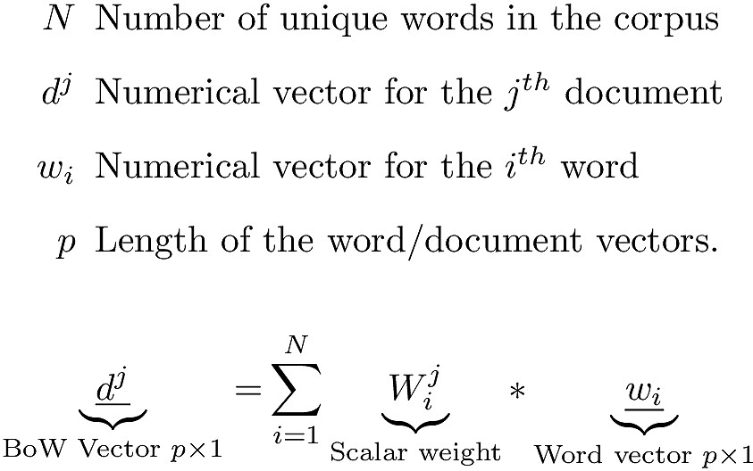
What is Bag of Words?
The document vector in the Bag-of-Words (BoW) technique is the weighted sum of the numerical vectors of the words that make up the document. The weight might simply be a tf-idf number, the frequency of the word in the text, or another variant.

Slide 5
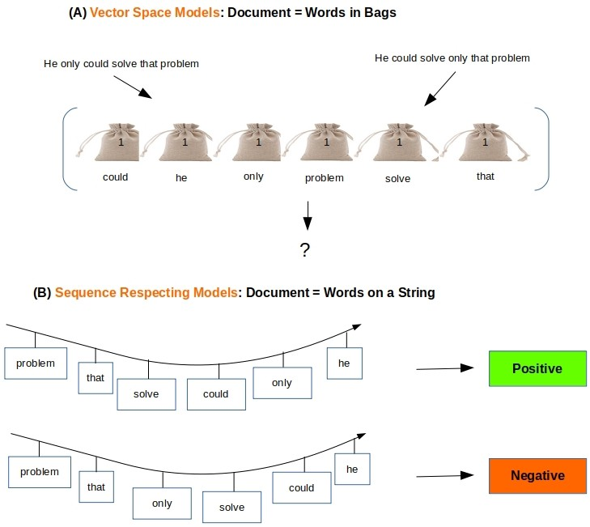
Shortcoming of the Bag of Words
The following graphic demonstrates a major flaw in the BoW vectors: they do not take into account the document's word order.

Slide 6
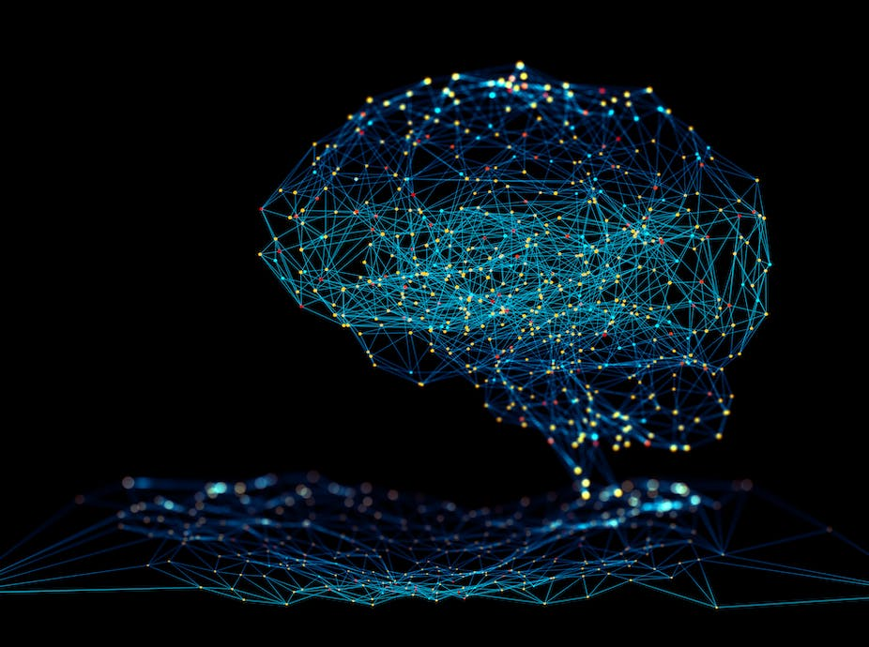

Shortcomings of Recurrent Neural Networks?
When it comes to evaluating complex data types like photos, videos, audio, and text, neural networks are a particularly successful sort of model.
Before the introduction of transformers, we used a model called a Recurrent Neural Network (RNN) to apply deep learning to text comprehension.
Disadvantages in RNN
Loss of Information
Vanishing Gradient

Slide 7
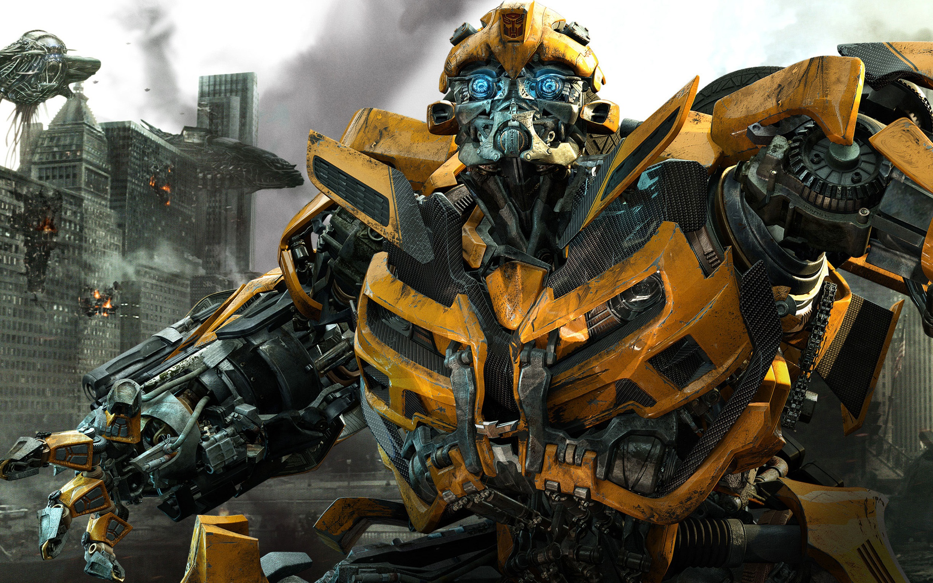
Transformer Changed Everything!!!
Transformers were initially designed to do translation.
Unlike RNNs, transformers can be efficiently parallelized.
How do Transformers work?
There are three main innovations that makes Transformers work really work:
Positional Encoding
Attention
Self Attention

Slide 8
How are Transformers used?
One of the most popular transformer-based models is called BERT.
BERT was trained on a massive text corpus.
BERT can perform bunch of different tasks:
Text Summarization
Question Answering
Classification, and finding similar sentences.
Used in Google Search to help understand search queries.

Slide 9

What is BERT???
Bidirectional Encoder Representations from Transformers
Bidirectional : BERT comes from the fact that it reads all the input words simultaneously.
Encoder: It is a program or algorithm used to learn a representation from a set of data.
Representation : This algorithm generates word embedding with number representation.
Transformers : It transforms from one sequence to another sequence.

Slide 10
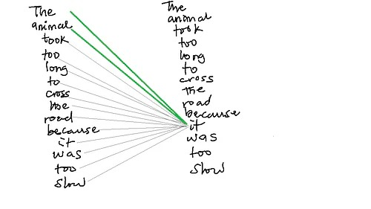
BERT’s functionality!!
BERT makes use of Transformer, an attention mechanism that learns contextual relations between words (or sub-words) in a text.
How BERT Works?
BERT was trained on two modelling methods:
Masked Language Model
Next Sentence Prediction

Slide 11

BERT v/s Word2Vec
Word2Vec models provide embeddings that are independent of context. In other words, each word has a unique vector representation.
The advantage of BERT is we can represent a single word in multiple different vectors depending on context. That is why BERT models are known to be context dependent.

Slide 12
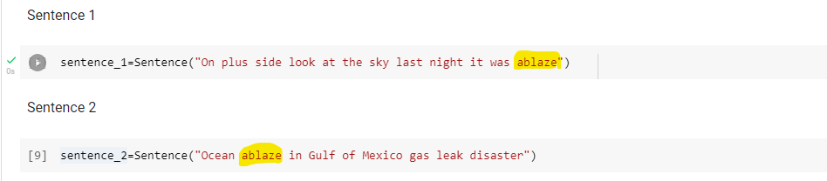
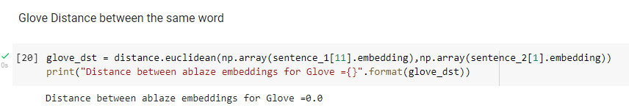
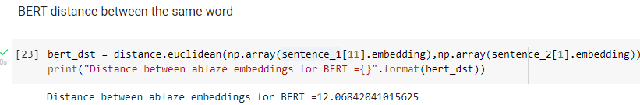
BERT V/s Word2Vec: Example

Slide 13
References
1. I. Maulana and W. Maharani, "Disaster Tweet Classification Based On Geospatial Data Using the BERT-MLP Method," 2021 9th International Conference on Information and Communication Technology (ICoICT), 2021, pp. 76-81, doi: 10.1109/ICoICT52021.2021.9527513.
2. Y. Chandra and A. Jana, "Sentiment Analysis using Machine Learning and Deep Learning," 2020 7th International Conference on Computing for Sustainable Global Development (INDIACom), 2020, pp. 1-4, doi: 10.23919/INDIACom49435.2020.9083703
3. L. Xukun and D. Caragea, "Improving Disaster-related Tweet Classification with a Multimodal Approach", ISCRAM 2020 Conference Proceedings-17th International Conference on Information Systems for Crisis Response and Management, 2020
4. Abhinav Kumar, Jyoti Prakash Singh, Yogesh K. Dwivedi and Nripendra P. Rana, A deep multi-modal neural network for informative Twitter content classification during emergencies, Springer, pp. 1-32, 2020

Slide 14


